Slide 1

Noida Institute of Engineering and Technology, Greater Noida
OBJECT ORIENTED TECHNIQUES USING JAVA(ACSE0302)
Unit: 5
Surya Prakash Sharma
Department
Of
Computer Sc & Engineering
Course Details
(B.Tech 3rd Sem /2nd Year)
Mr. Surya Prakash Sharma UNIT - 5 ACSE0302/AMICSE0302 OBJECT ORIENTED TECHNIQUES USING JAVA

Slide 2
What is GUI
A GUI represents an application that has a visual display for the user with easy to use controls.
A GUI generally consists of graphical components like windows, frames, buttons, labels, etc.
We can use these components to interact with the system or even the outside world.
Java provides many APIs and reusable classes using which we can develop GUI applications. One of the oldest kits provided by Java is ‘Abstract Windowing ToolKit” or AWT.
All newer APIs or components like Swing; JavaFX, etc. are based on this AWT.
The GUI contains a sequence of activities that also trigger some events that in turn execute some actions on invoking a component or part of a component like by clicking a button we trigger some actions.
Mr. Surya Prakash Sharma UNIT - 5 ACSE0302/AMICSE0302 OBJECT ORIENTED TECHNIQUES USING JAVA

Slide 3
What is GUI
So a GUI application is a framework consisting of graphical components & events that can be triggered on these components and the actions that execute as a result of events trigger.
Framework:- Frameworks usually provide precompiled reusable classes and components that we can drag and drop in the drawing area and then associate the events and actions with these components.
Mr. Surya Prakash Sharma UNIT - 5 ACSE0302/AMICSE0302 OBJECT ORIENTED TECHNIQUES USING JAVA

Slide 4
Window Fundamentals
Component
Component is an abstract class that encapsulates all of the attributes of a visual component.
All user interface elements that are displayed on the screen and that interact with the user are subclasses of Component.
It defines over a hundred public methods that are responsible for managing events, such as mouse and keyboard input, positioning and sizing the window, and repainting..
Container
The Container class is a subclass of Component.
It has additional methods that allow other Component objects to be nested within it.
Other Container objects can be stored inside of a Container (since they are themselves instances of Component).
Mr. Surya Prakash Sharma UNIT - 5 ACSE0302/AMICSE0302 OBJECT ORIENTED TECHNIQUES USING JAVA

Slide 5
Window Fundamentals
Panel
The Panel class is a concrete subclass of Container.
Panel is a window that does not contain a title bar, menu bar, or border. This is why you don’t see these items when an applet is run inside a browser.
components can be by its add( ) method (inherited from Container).
Added components position and resize manually using the setLocation( ), setSize( ), setPreferredSize( ), or setBounds( ) methods defined by Component
Window class
The Window class creates a top-level window.
It is not contained within any other object. it sits directly on the desktop.
Window objects created using Window called Frame. A window does not have borders or menu bars.
Mr. Surya Prakash Sharma UNIT - 5 ACSE0302/AMICSE0302 OBJECT ORIENTED TECHNIQUES USING JAVA

Slide 6
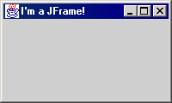
Window Fundamentals
Frame :-
It is a subclass of Window and has a title bar, menu bar, borders, and resizing corners. If you create a Frame object from within an applet, it will contain a warning message, such as “Java Applet Window,” to the user that an applet window has been created.
Mr. Surya Prakash Sharma UNIT - 5 ACSE0302/AMICSE0302 OBJECT ORIENTED TECHNIQUES USING JAVA

Slide 7
AWT
Java AWT (Abstract Window Toolkit) is an Java API to develop Graphical User Interface (GUI) or windows-based applications in Java.
It is a platform-dependent framework i.e. the GUI components belonging to AWT are not the same across all platforms.
Due to its platform dependence and a kind of heavyweight nature of its components, it is rarely used in Java applications these days. Besides, there are also newer frameworks like Swing which are light-weight and platform-independent.
Swing has more flexible and powerful components when compared to AWT. Swing provides components similar to Abstract Window Toolkit and also has more advanced components like trees, tabbed panels, etc.
Java Swing framework is based on the AWT.
Mr. Surya Prakash Sharma UNIT - 5 ACSE0302/AMICSE0302 OBJECT ORIENTED TECHNIQUES USING JAVA

Slide 8
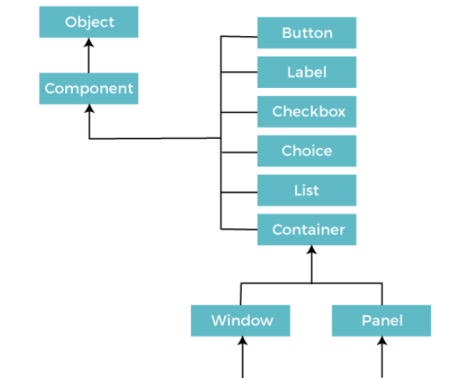

Java AWT Hierarchy
Mr. Surya Prakash Sharma UNIT - 5 ACSE0302/AMICSE0302 OBJECT ORIENTED TECHNIQUES USING JAVA

Slide 9
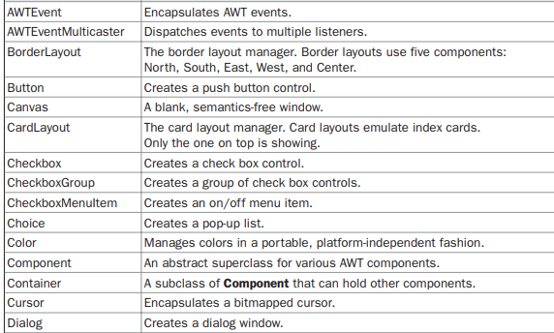

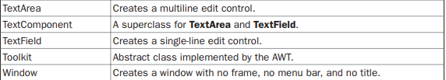
AWT Classes
Mr. Surya Prakash Sharma UNIT - 5 ACSE0302/AMICSE0302 OBJECT ORIENTED TECHNIQUES USING JAVA

Slide 10
Java GUI frameworks
Java provides the following main frameworks.
Java provides the following frameworks for GUI programming:
Abstract Windowing Toolkit: This is the oldest framework in Java and it was first introduced in JDK 1.0. Most of the AWT components are now outdated and are replaced by Java swing components.
Swing API: This is a set of graphical libraries developed on top of the AWT framework and is a part of Java Foundation Classes (JFC). Swing has modular architecture wherein we can use plug-and-play for the components.
JavaFX: The latest framework is available from Java 8 onwards.
Java provides a set of features and functionality for developing graphical user interfaces or GUIs. This set of features is known as Java Foundation Classes or JFC. JFC contains classes from java.awt and javax.swing packages.
Mr. Surya Prakash Sharma UNIT - 5 ACSE0302/AMICSE0302 OBJECT ORIENTED TECHNIQUES USING JAVA

Slide 11
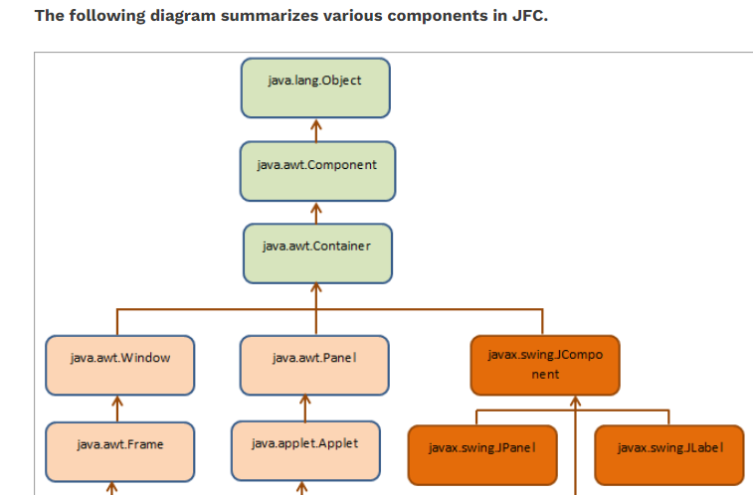
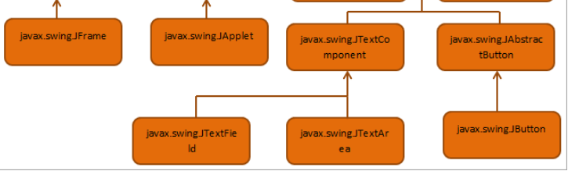
JFC Java Foundation Classes
Mr. Surya Prakash Sharma UNIT - 5 ACSE0302/AMICSE0302 OBJECT ORIENTED TECHNIQUES USING JAVA

Slide 12
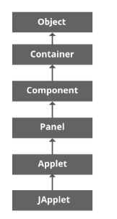
Applet
Applet is a special type of program that is embedded in the webpage to generate the dynamic content. It runs inside the browser and works at client side.
All applets are sub-classes (either directly or indirectly) of java.applet.Applet class. Applets are not stand-alone programs. They run either within a web browser or an applet viewer.
Applet Class Hierarchy
Mr. Surya Prakash Sharma UNIT - 5 ACSE0302/AMICSE0302 OBJECT ORIENTED TECHNIQUES USING JAVA

Slide 13
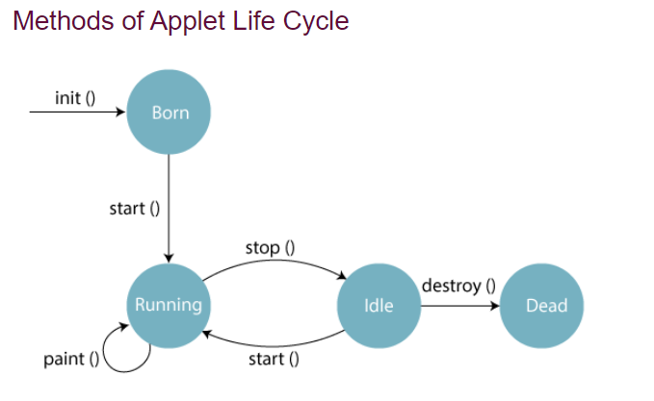
Applet Life Cycle
Life cycle for Applet
The applet life cycle can be defined as the process of how the object is created, started, stopped, and destroyed during the entire execution of its application. It basically has five core methods namely init(), start(), stop(), paint() and destroy().These methods are invoked by the browser to execute.
Mr. Surya Prakash Sharma UNIT - 5 ACSE0302/AMICSE0302 OBJECT ORIENTED TECHNIQUES USING JAVA

Slide 14
Applet Life Cycle
Lifecycle methods for Applet:
The java.applet.Applet class 4 life cycle methods and java.awt.Component class provides 1 life cycle methods for an applet.
java.applet.Applet class
For creating any applet java.applet.Applet class must be inherited. It provides 4 life cycle methods of applet.
1. public void init(): is used to initialized the Applet. It is invoked only once.
2.public void start(): is invoked after the init() method or browser is maximized. It is used to start the Applet.
3. public void stop(): is used to stop the Applet. It is invoked when Applet is stop or browser is minimized.
4. public void destroy(): is used to destroy the Applet. It is invoked only once.
java.awt.Component class
The Component class provides 1 life cycle method of applet.
5. public void paint(Graphics g): is used to paint the Applet. It provides Graphics class object that can be used for drawing oval, rectangle, arc etc.
Mr. Surya Prakash Sharma UNIT - 5 ACSE0302/AMICSE0302 OBJECT ORIENTED TECHNIQUES USING JAVA

Slide 15
How create & Run the Applet Program
Creating Applet
java.applet.Applet class
For creating any applet java.applet.Applet class must be inherited.
Who is responsible to manage the life cycle of an applet?
Java Plug-in software.
How to run an Applet?
There are two ways to run an applet
1. By html file.
2. By appletViewer tool
Mr. Surya Prakash Sharma UNIT - 5 ACSE0302/AMICSE0302 OBJECT ORIENTED TECHNIQUES USING JAVA

Slide 16
Example 1 – Execute program by using HTML file
import java.applet.Applet;
import java.awt.Graphics;
public class FirstApplet extends Applet{
public void paint(Graphics g){
g.drawString("welcome",150,150);
}
}
Save File :- FirstApplet.java
Compile :- javac FirstApplet.java
Run The Program by using HTML File
Create a new text File(in notepad)
<html>
<body>
<applet code="FirstApplet.class" width="300" height="300">
</applet>
</body>
</html>
Save File :- Test.html
Run :-
Click on Test
Mr. Surya Prakash Sharma UNIT - 5 ACSE0302/AMICSE0302 OBJECT ORIENTED TECHNIQUES USING JAVA

Slide 17
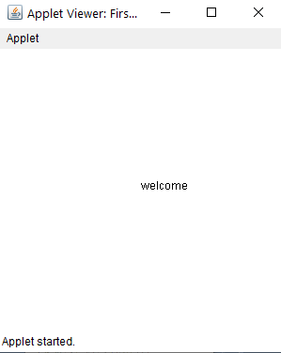
Example 1 – Execute program by using appletviewer
import java.applet.Applet;
import java.awt.Graphics;
public class FirstApplet extends Applet{
public void paint(Graphics g){
g.drawString("welcome",150,150);
}
}
Save File :- FirstApplet.java
Compile :- javac FirstApplet.java
Run The Program by using HTML File
Create a new text File(in notepad)
<html>
<body>
<applet code="FirstApplet.class" width="300" height="300">
</applet>
</body>
</html>
Save File :- Test.html
Run :- appletviewer Test.html
Mr. Surya Prakash Sharma UNIT - 5 ACSE0302/AMICSE0302 OBJECT ORIENTED TECHNIQUES USING JAVA

Slide 18
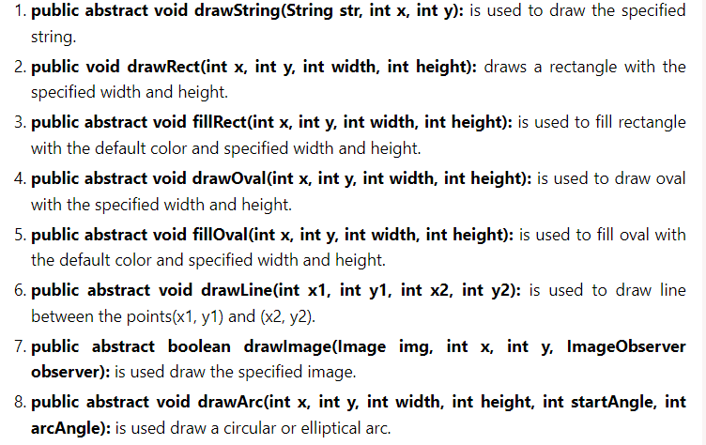
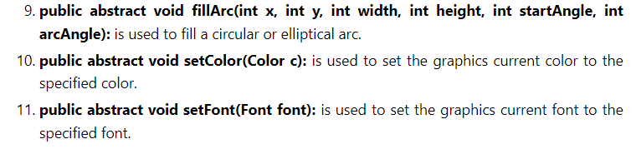
Displaying Graphics in Applet
Mr. Surya Prakash Sharma UNIT - 5 ACSE0302/AMICSE0302 OBJECT ORIENTED TECHNIQUES USING JAVA

Slide 19
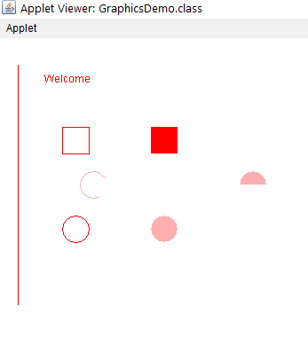
Example 2 – Graphics Program
import java.applet.Applet;
import java.awt.*;
public class GraphicsDemo extends Applet{
public void paint(Graphics g){
g.setColor(Color.red);
g.drawString("Welcome",50, 50);
g.drawLine(20,30,20,300);
g.drawRect(70,100,30,30);
g.fillRect(170,100,30,30);
g.drawOval(70,200,30,30);
g.setColor(Color.pink);
g.fillOval(170,200,30,30);
g.drawArc(90,150,30,30,30,270);
g.fillArc(270,150,30,30,0,180);
} }
Run The Program by using HTML File
Create a new text File(in notepad)
<html>
<body>
<applet code=" GraphicsDemo.class" width="300" height="300">
</applet>
</body>
</html>
Save File :- Test.html
Run :- appletviewer Test.html
Mr. Surya Prakash Sharma UNIT - 5 ACSE0302/AMICSE0302 OBJECT ORIENTED TECHNIQUES USING JAVA

Slide 20
Event handling
Event :
It is an object that descrives a state change in a source
Event Source:
A source is an object that generate evet.
Event Delegation Model:
A source generate an event and send it to one or more listeners.
The listener simply waits until it receives an event.
Once it received event the listener process the event and then return.
Mr. Surya Prakash Sharma UNIT - 5 ACSE0302/AMICSE0302 OBJECT ORIENTED TECHNIQUES USING JAVA

Slide 21
Event Delegation Model
Steps:
Create component object(eg. Button checkbox)
Add the component on platform (applet, frame, panel)
Register the respective listener
Implement Action performed() method
Mr. Surya Prakash Sharma UNIT - 5 ACSE0302/AMICSE0302 OBJECT ORIENTED TECHNIQUES USING JAVA

Slide 22
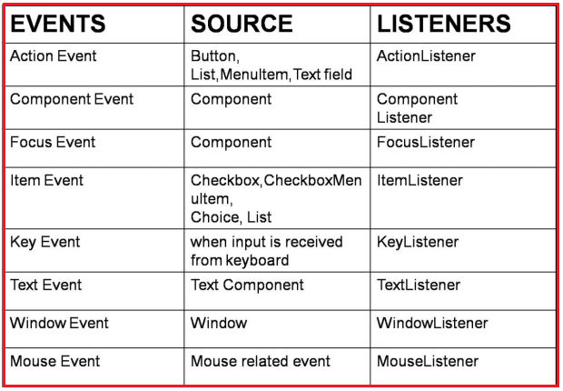
List of Listeners
Mr. Surya Prakash Sharma UNIT - 5 ACSE0302/AMICSE0302 OBJECT ORIENTED TECHNIQUES USING JAVA

Slide 23
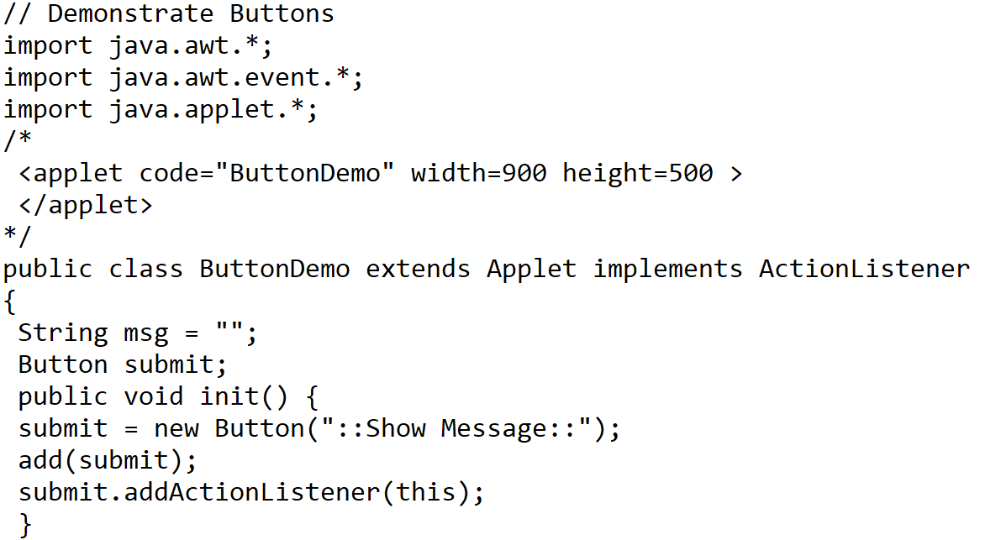
Example ActionEvent
Mr. Surya Prakash Sharma UNIT - 5 ACSE0302/AMICSE0302 OBJECT ORIENTED TECHNIQUES USING JAVA

Slide 24
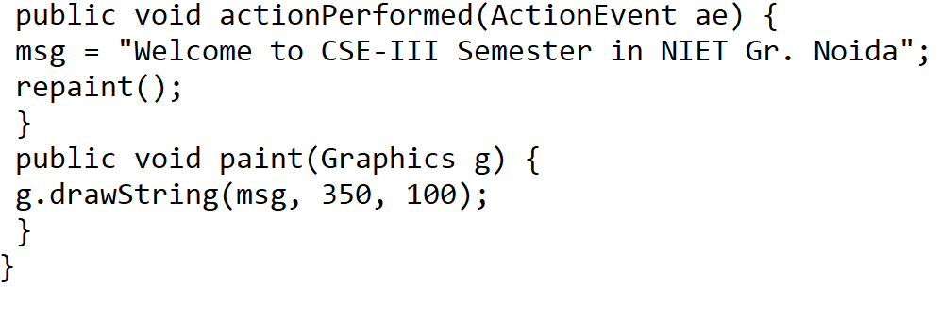
Example ActionEvent
Mr. Surya Prakash Sharma UNIT - 5 ACSE0302/AMICSE0302 OBJECT ORIENTED TECHNIQUES USING JAVA

Slide 25
Layout Manager
it is used to arrange components in a particular manner.
It facilitates us to control the positioning and size of the components in GUI forms.
classes that represent the layout managers:
java.awt.BorderLayout
java.awt.FlowLayout
java.awt.GridLayout
java.awt.CardLayout
java.awt.GridBagLayout
javax.swing.BoxLayout
javax.swing.GroupLayout
javax.swing.ScrollPaneLayout
javax.swing.SpringLayout
Mr. Surya Prakash Sharma UNIT - 5 ACSE0302/AMICSE0302 OBJECT ORIENTED TECHNIQUES USING JAVA

Slide 26
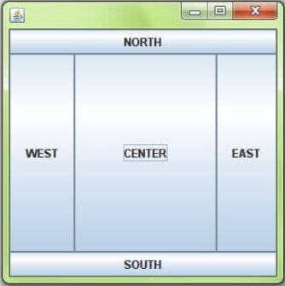
BorderLayout
Java BorderLayout
It is used to arrange the components in five regions: north, south, east, west, and center. Each region (area) may contain one component only. It is the default layout of a frame or window.
public static final int NORTH
public static final int SOUTH
public static final int EAST
public static final int WEST
public static final int CENTER
Constructors of BorderLayout class:-
BorderLayout(): no gaps between the components.
BorderLayout(int hgap, int vgap): gives horizontal and vertical gaps between the components.
Mr. Surya Prakash Sharma UNIT - 5 ACSE0302/AMICSE0302 OBJECT ORIENTED TECHNIQUES USING JAVA

Slide 27
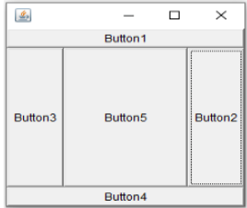
Example to demonstrate Border Layout in Java
import java.awt.*;
public class BorderLayoutDemo
{
public static void main (String[]args)
{
Frame f1 = new Frame ();
f1.setSize (250, 250);
Button b1 = new Button ("Button1");
Button b2 = new Button ("Button2");
Button b3 = new Button ("Button3");
Button b4 = new Button ("Button4");
Button b5 = new Button ("Button5");
f1.add (b1, BorderLayout.NORTH);
f1.add (b2, BorderLayout.EAST);
f1.add (b3, BorderLayout.WEST);
f1.add (b4, BorderLayout.SOUTH);
f1.add (b5);
f1.setVisible (true);
}
}
Output
Mr. Surya Prakash Sharma UNIT - 5 ACSE0302/AMICSE0302 OBJECT ORIENTED TECHNIQUES USING JAVA

Slide 28
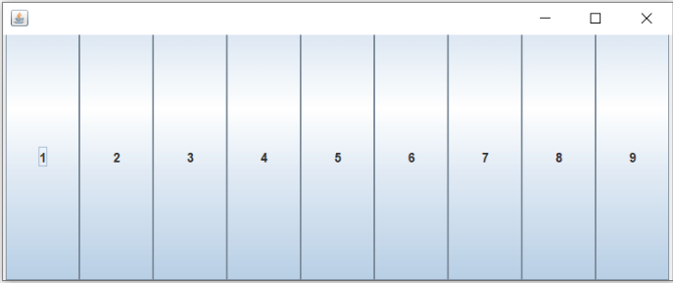
GridLayout
it is used to arrange the components in a rectangular grid. One component is displayed in each rectangle.
Constructors of GridLayout class
GridLayout(): one column per component in a row.
GridLayout(int rows, int columns): given rows and columns but no gaps between the components.
GridLayout(int rows, int columns, int hgap, int vgap): given rows and columns along with given horizontal and vertical gaps.
Mr. Surya Prakash Sharma UNIT - 5 ACSE0302/AMICSE0302 OBJECT ORIENTED TECHNIQUES USING JAVA

Slide 29
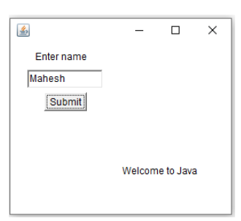
Example to demonstrate Grid Layout in Java
import java.awt.*;
import javax.swing.*;
public class GridLayoutDemo
{
public static void main (String[]args)
{
Frame f1 = new Frame ();
f1.setSize (250, 250);
GridLayout ob = new GridLayout (2, 2);
f1.setLayout (ob);
Panel p1 = new Panel ();
Label l1 = new Label ("Enter name");
TextField tf = new TextField (10);
Button b1 = new Button ("Submit");
p1.add (l1);
p1.add (tf);
p1.add (b1);
f1.add (p1);
Panel p2 = new Panel ();
f1.add (p2);
Panel p3 = new Panel ();
f1.add (p3);
Label l2 = new Label ("Welcome to Java");
f1.add (l2);
f1.setVisible (true);
}
}
Output
Mr. Surya Prakash Sharma UNIT - 5 ACSE0302/AMICSE0302 OBJECT ORIENTED TECHNIQUES USING JAVA

Slide 30
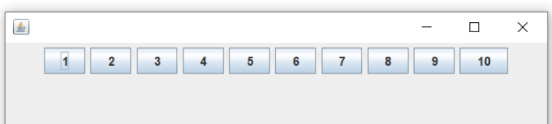
FlowLayout
it is used to arrange the components in a line, one after another (in a flow). It is the default layout of the applet or panel.
Fields of FlowLayout class
public static final int LEFT
public static final int RIGHT
public static final int CENTER
public static final int LEADING
public static final int TRAILING
Constructors of FlowLayout class
FlowLayout(): creates a flow layout with centered alignment and a default 5 unit horizontal and vertical gap.
FlowLayout(int align): creates a flow layout with the given alignment and a default 5 unit horizontal and vertical gap.
FlowLayout(int align, int hgap, int vgap): creates a flow layout with the given alignment and the given horizontal and vertical gap.
Mr. Surya Prakash Sharma UNIT - 5 ACSE0302/AMICSE0302 OBJECT ORIENTED TECHNIQUES USING JAVA

Slide 31
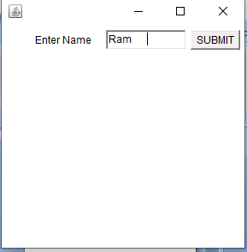
Example to demonstrate Flow Layout in Java
import java.awt.*;
//import javax.swing.*;
public class FlowLayoutDemo
{
Frame f;
FlowLayoutDemo ()
{
f = new Frame ();
Label l1 = new Label ("Enter Name");
TextField tf1 = new TextField (10);
Button b1 = new Button ("SUBMIT");
f.add (l1);
f.add (tf1);
f.add (b1);
f.setLayout (new FlowLayout (FlowLayout.RIGHT));
//setting flow layout of right alignment
f.setSize (300, 300);
f.setVisible (true);
}
public static void main (String[]args)
{
new FlowLayoutDemo ();
}
}
Output
Mr. Surya Prakash Sharma UNIT - 5 ACSE0302/AMICSE0302 OBJECT ORIENTED TECHNIQUES USING JAVA

Slide 32
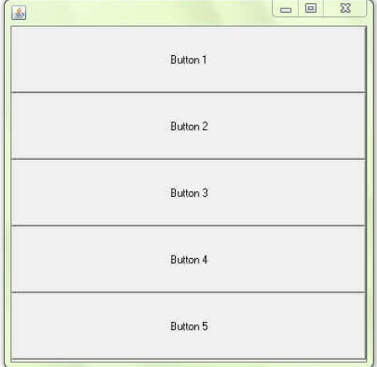
BoxLayout
The Java BoxLayout class is used to arrange the components either vertically or horizontally. For this purpose, the BoxLayout class provides four constants.
Fields of BoxLayout Class
public static final int X_AXIS: Alignment of the components are horizontal from left to right.
public static final int Y_AXIS: Alignment of the components are vertical from top to bottom.
public static final int LINE_AXIS: - Alignment of the components is similar to the way words are aligned in a line, which is based on the ComponentOrientation property of the container.
public static final int PAGE_AXIS: Alignment of the components is similar to the way text lines are put on a page, which is based on the ComponentOrientation property of the container.
Constructor of BoxLayout class
BoxLayout(Container c, int axis): creates a box layout that arranges the components with the given axis.
Mr. Surya Prakash Sharma UNIT - 5 ACSE0302/AMICSE0302 OBJECT ORIENTED TECHNIQUES USING JAVA

Slide 33
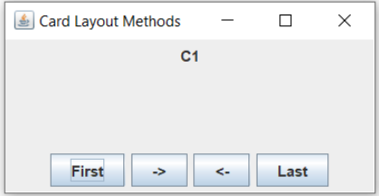
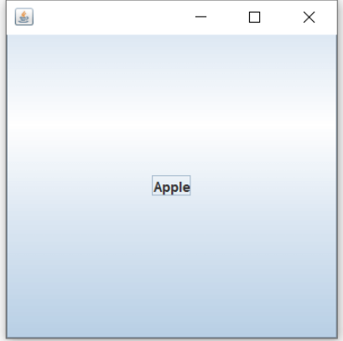
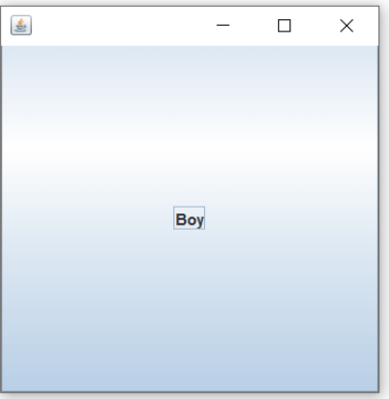

CardLayout
it manages the components in such that only one component is visible at a time. It treats each component as a card that is why it is known as CardLayout.
Constructors of CardLayout Class
CardLayout(): zero horizontal and vertical gap.
CardLayout(int hgap, int vgap) with the given horizontal and vertical gap.
Commonly Used Methods of CardLayout Class
public void next(Container parent): is used to flip to the next card of the given container.
public void previous(Container parent): is used to flip to the previous card of the given container.
public void first(Container parent): is used to flip to the first card of the given container.
public void last(Container parent): is used to flip to the last card of the given container.
public void show(Container parent, String name): is used to flip to the specified card with the given name.
Mr. Surya Prakash Sharma UNIT - 5 ACSE0302/AMICSE0302 OBJECT ORIENTED TECHNIQUES USING JAVA

Slide 34
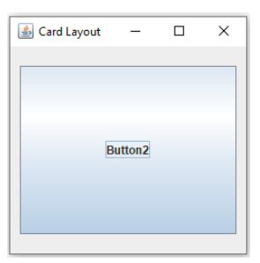
Example to demonstrate Card Layout in Java
import java.awt.*;
import javax.swing.*;
import javax.swing.JButton;
import java.awt.event.*;
public class CardLayoutDemo1 extends Jframe
implements ActionListener
{
JButton b1, b2, b3, b4, b5;
CardLayout cl;
Container c;
CardLayoutDemo1 ()
{
b1 = new JButton ("Button1");
b2 = new JButton ("Button2");
b3 = new JButton ("Button3");
b4 = new JButton ("Button4");
b5 = new JButton ("Button5");
c = this.getContentPane ();
cl = new CardLayout (10, 20);
c.setLayout (cl);
c.add ("Card1", b1);
c.add ("Card2", b2);
c.add ("Card3", b3);
b1.addActionListener (this);
b2.addActionListener (this);
b3.addActionListener (this);
setVisible (true);
setSize (400, 400);
setTitle ("Card Layout");
setDefaultCloseOperation (JFrame.EXIT_ON_CLOSE);
} public void actionPerformed (ActionEvent ae)
{
cl.next (c);
}public static void main (String[]args)
{
new CardLayoutDemo ();
}
}
Mr. Surya Prakash Sharma UNIT - 5 ACSE0302/AMICSE0302 OBJECT ORIENTED TECHNIQUES USING JAVA

Slide 35
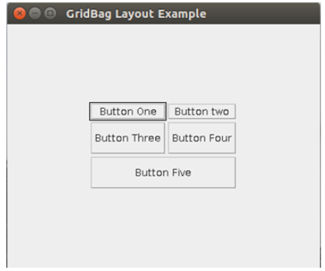
GridBag Layout
The Java GridBagLayout class is used to align components vertically, horizontally or along their baseline.
The components may not be of the same size. Each GridBagLayout object maintains a dynamic, rectangular grid of cells. Each component occupies one or more cells known as its display area.
Mr. Surya Prakash Sharma UNIT - 5 ACSE0302/AMICSE0302 OBJECT ORIENTED TECHNIQUES USING JAVA

Slide 36
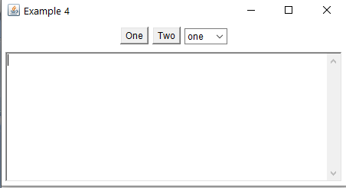
Example:- 1
import java.awt.*;
public class Example4 extends java.applet.Applet
{
public void init()
{
Panel p;
setLayout(new BorderLayout());
p = new Panel();
p.add(new TextArea());
add("Center", p);
p = new Panel();
p.add(new Button("One"));
p.add(new Button("Two"));
Choice c = new Choice();
c.addItem("one");
c.addItem("two");
c.addItem("three");
p.add(c);
add("North", p);
}}
public static void main(String [] args)
{
Frame f = new Frame("Example 4");
Example4 ex = new Example4();
ex.init();
f.add("Center", ex);
f.pack();
f.show();
}
}
Output
Mr. Surya Prakash Sharma UNIT - 5 ACSE0302/AMICSE0302 OBJECT ORIENTED TECHNIQUES USING JAVA

Slide 37
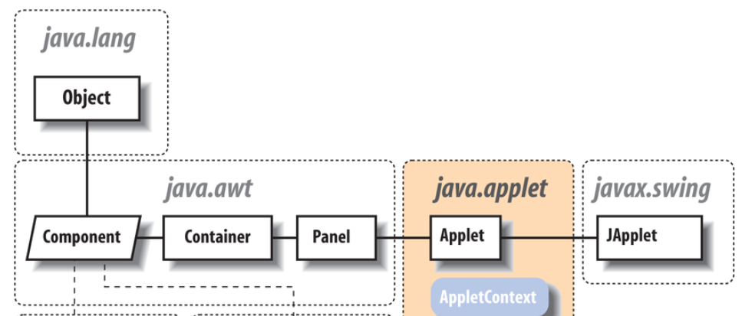
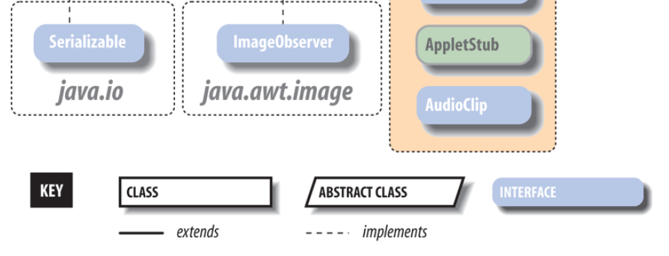
jApplet
JApplet is a simple extension of java.applet.Applet to use when creating Swing programs designed to be used in a web browser (or appletviewer ). As a direct subclass of Applet, JApplet is used in much the same way, with the init( ) , start( ), and stop( ) methods still playing critical roles.
Mr. Surya Prakash Sharma UNIT - 5 ACSE0302/AMICSE0302 OBJECT ORIENTED TECHNIQUES USING JAVA

Slide 38
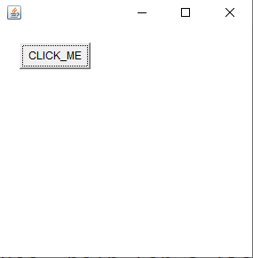
A-frame can be created in two ways
#1) By using the Frame class object
Here, we create a Frame class object by
instantiating the Frame class.
import java.awt.*;
class FrameButton{
FrameButton (){
Frame f=new Frame();
Button b=new Button("CLICK_ME");
b.setBounds(30,50,80,30);
f.add(b);
f.setSize(300,300);
f.setLayout(null);
f.setVisible(true);
}
public static void main(String args[]){
FrameButton f=new FrameButton ();
}
}
Save File :- FramButton.java
Output
Mr. Surya Prakash Sharma UNIT - 5 ACSE0302/AMICSE0302 OBJECT ORIENTED TECHNIQUES USING JAVA

Slide 39
Cont……
#2) By Extending the Frame class
import java.awt.*;
class AWTButton extends Frame{
AWTButton (){
Button b=new Button("AWTButton");
b.setBounds(30,100,80,30);// setting button
position
add(b);//adding button into frame
setSize(300,300);//frame size 300 width and
300 height
setLayout(null);//no layout manager
setVisible(true);//now frame will be visible,
by default not visible
} public static void main(String args[]){
AWTButton f=new AWTButton (); }}
Mr. Surya Prakash Sharma UNIT - 5 ACSE0302/AMICSE0302 OBJECT ORIENTED TECHNIQUES USING JAVA

Slide 40
working with generics in java
Generics means parameterized types
The idea is to allow type (Integer, String, … etc., and user-defined types) to be a parameter to methods, classes, and interfaces.
Using Generics, it is possible to create classes that work with different data types. An entity such as class, interface, or method that operates on a parameterized type is a generic entity.
Mr. Surya Prakash Sharma UNIT - 5 ACSE0302/AMICSE0302 OBJECT ORIENTED TECHNIQUES USING JAVA

Slide 41
Generics Class
class MyGen<T>{
T obj;
void add(T obj)
{ this.obj=obj;
}
T get()
{ return obj;
}
}
class TestGenerics3{
public static void main(String args[]){
MyGen<Integer> m=new MyGen<Integer>();
m.add(20);
System.out.println(m.get());
MyGen<String> m=new MyGen<String>();
m.add(“Rohan”);
System.out.println(m.get());
}
}
Output
20
Rohan
Mr. Surya Prakash Sharma UNIT - 5 ACSE0302/AMICSE0302 OBJECT ORIENTED TECHNIQUES USING JAVA

Slide 42
Generics Method
class MyGeneric {
// creae a generics method
public <T> void gMethod(T data) {
System.out.println("Generics Method:");
System.out.println(“Values: " + data);
}
}
class Test {
public static void main(String[] args) {
MyGeneric obj= new MyGeneric();
// for String data
obj.<String>gMethod(“Hi! Welcome");
// for integer data
obj.<Integer>gMethod(25);
}
}
Output:
Generics Method:
Values: Hi! Welcome
Generics Method:
Values: 25
Mr. Surya Prakash Sharma UNIT - 5 ACSE0302/AMICSE0302 OBJECT ORIENTED TECHNIQUES USING JAVA

